Slide 1


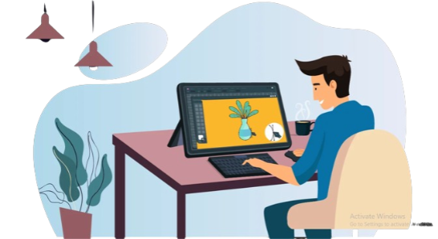
CSA 0810-Python Programming-Slot B
Image Editing using Python
Guide By,
T. Vincent Gnanaraj
(Course Faculty)
Python Programming
SSE, SIMATS
Project by,
P. Sree Sai Vardhan Reddy
(192210072)
Computer Science & Engineering
SSE, SIMATS

Slide 2
Introduction
Pythons clear and concise syntax makes it an ideal choice for scripting in image editing
Python boasts a plethora of libraries tailored for image processing, such as pillow(PIL), OpenCV, and scikit-image.
Python ability to manipulate data at the pixel level facilitates precise control over image elements.
Python enables real time image editing
Python’s open source nature encourages continuous improvement and customization.
Developers can contribute to or modify existing image editing tools, fostering a collaborative environment for innovation.
This project show how python is used for image editing and how it a better language for this kind of the editors

Slide 3
Abstract
This project involves the development of an image editor using Python, a language renowned for its simplicity and versatility. The objective is to create a tool that caters to both novice users and coding enthusiasts, offering a seamless blend of artistic expression and programming prowess. The editor will feature a range of essential image editing functions, including color manipulation, filters, and transformations. Through a carefully crafted user interface, the project aims to democratize the world of image editing, making it accessible to individuals with varying levels of programming expertise. The underlying codebase will showcase the elegance and efficiency of Python, demonstrating its aptitude for creative applications.
Keywords:Python, Image Editing, Creative Coding, User Friendly

Slide 4
Hardware and Software Requirements
Hardware Requirements:
CPU:11th Gen intel core i5
RAM:8 or above
GPU:Integrated graphics card
Storage Space Needed:4gb(Expected)
Software Requirements:
SDK:Python 3.11 version 6
Editor:IDLE, Spyder, Visual studio etc
Package:Pillow, Tkinter
Os:Windows 10 or 11 64 bit

Slide 5
Existing System
Image editor is used by many of the companies to edit the images.
Some of the image editing apps are:
GIMP(GNU Image Manipulation program):It is image editing app which uses python and primarily written in c
Paint.NET with PythonNet:it is a popular image editor, can be extended using python
Blender:It is a popular editing app and power full image and video editing app which uses python for scripting
Krita:Krita is a free and open source editor which primarily uses python but can be extended by using python

Slide 6
Proposed System
Semantic Recognition: Implement a deep learning-based semantic recognition module to enable the system to understand and identify objects, scenes, and context within images.
Real-time Editing: Develop an efficient real-time editing engine that provides instant previews of edits, enhancing user experience and responsiveness.
Generative Models: Integrate generative models like GANs to enhance image content, generating realistic textures, details, or new elements based on user preferences.
Personalization: Create a personalization engine that analyzes user editing history and style preferences to offer tailored recommendations, streamlining the editing process.
Ethical AI Measures: Implement features to ensure ethical use, preventing the generation of inappropriate content or deepfakes, and promoting responsible usage of the AI-powered image editing system.

Slide 7
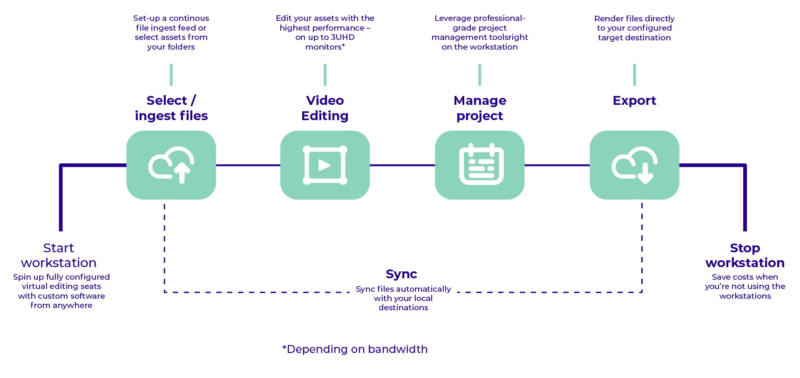
Architecture

Slide 8
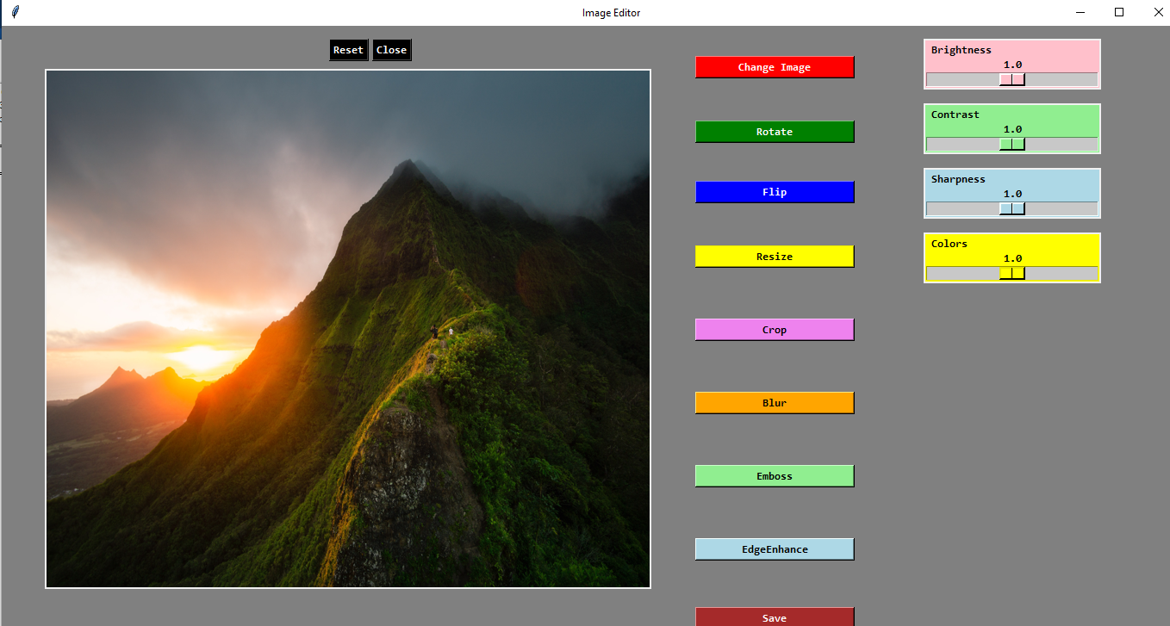
Design

Slide 9
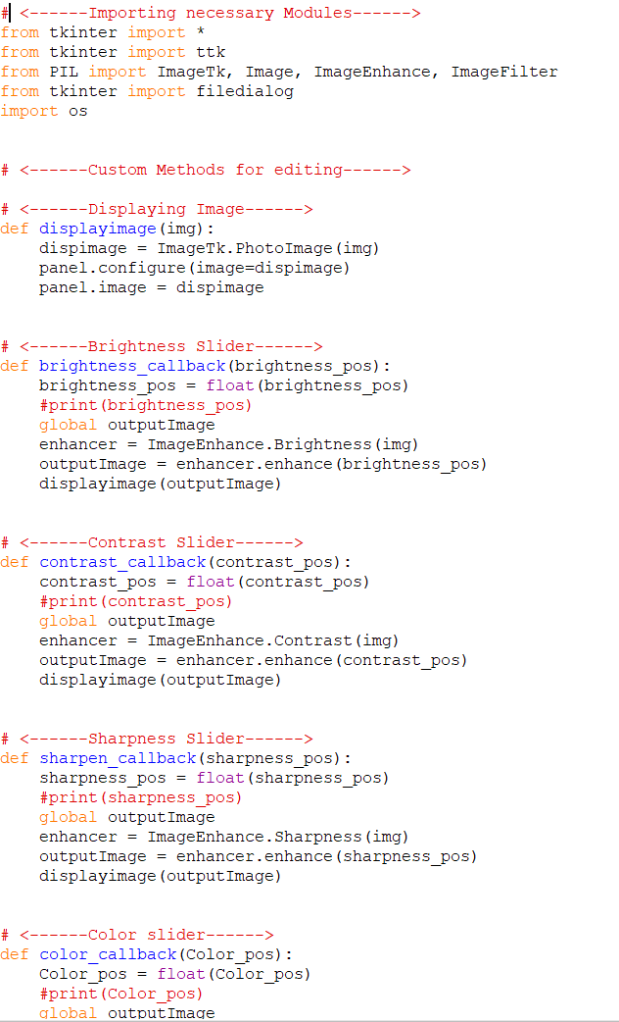
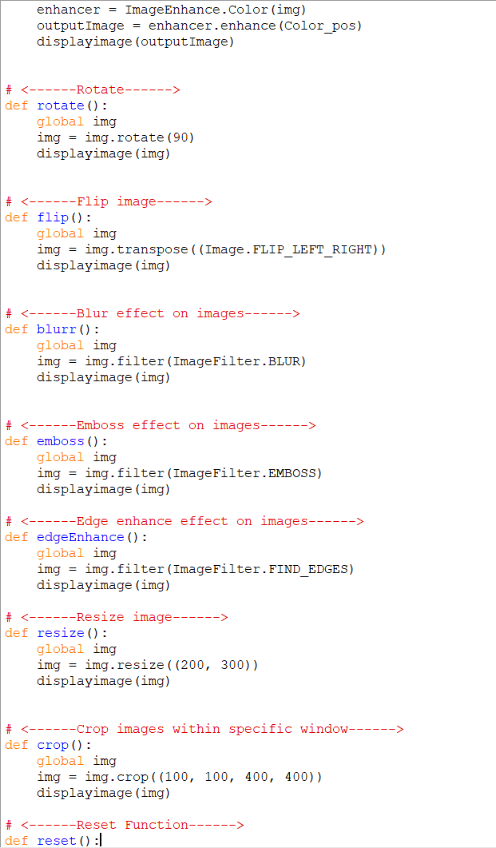
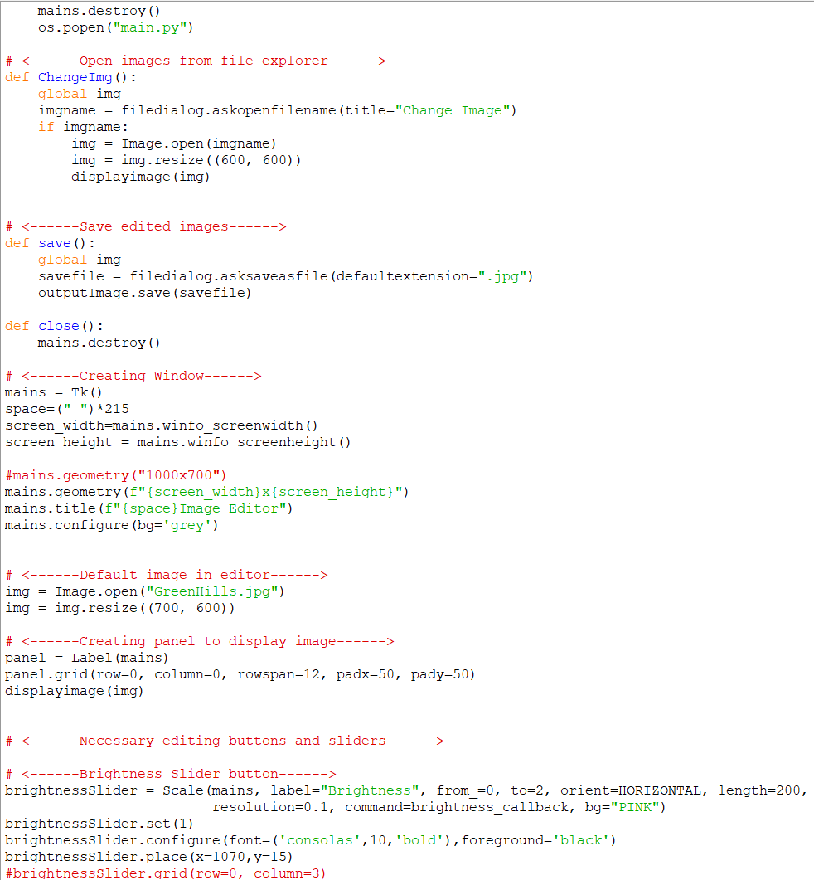
Coding

Slide 10
Testing
Unit Testing:Focus on testing specific functionalities, such as image loading, processing algorithms, and saving.
Integration Testing:Test the interaction between different components of your image editor.
Performance Testing:Evaluate the performance of your image editor using tools like pytest-benchmark to ensure that it meets acceptable speed and resource usage criteria.
End-to-End: Testing:For a more comprehensive evaluation, consider automated end-to-end testing using tools like Selenium for GUI testing or frameworks like PyTest-BDD for behavior-driven development testing.

Slide 11
Implementing
Python Utilization: Employed Python as the primary programming language for its versatility and extensive libraries.
OpenCV Integration: Leveraged OpenCV for image processing tasks, streamlining implementation and enhancing efficiency.
Modular Code Design: Implemented a modular code structure for clarity, ease of maintenance, and future scalability.
Parameter Tuning: Fine-tuned algorithm parameters to balance image enhancement and computational efficiency.
Version Control: Utilized version control (e.g., Git) for collaborative development, enabling seamless integration of enhancements and tracking changes

Slide 12
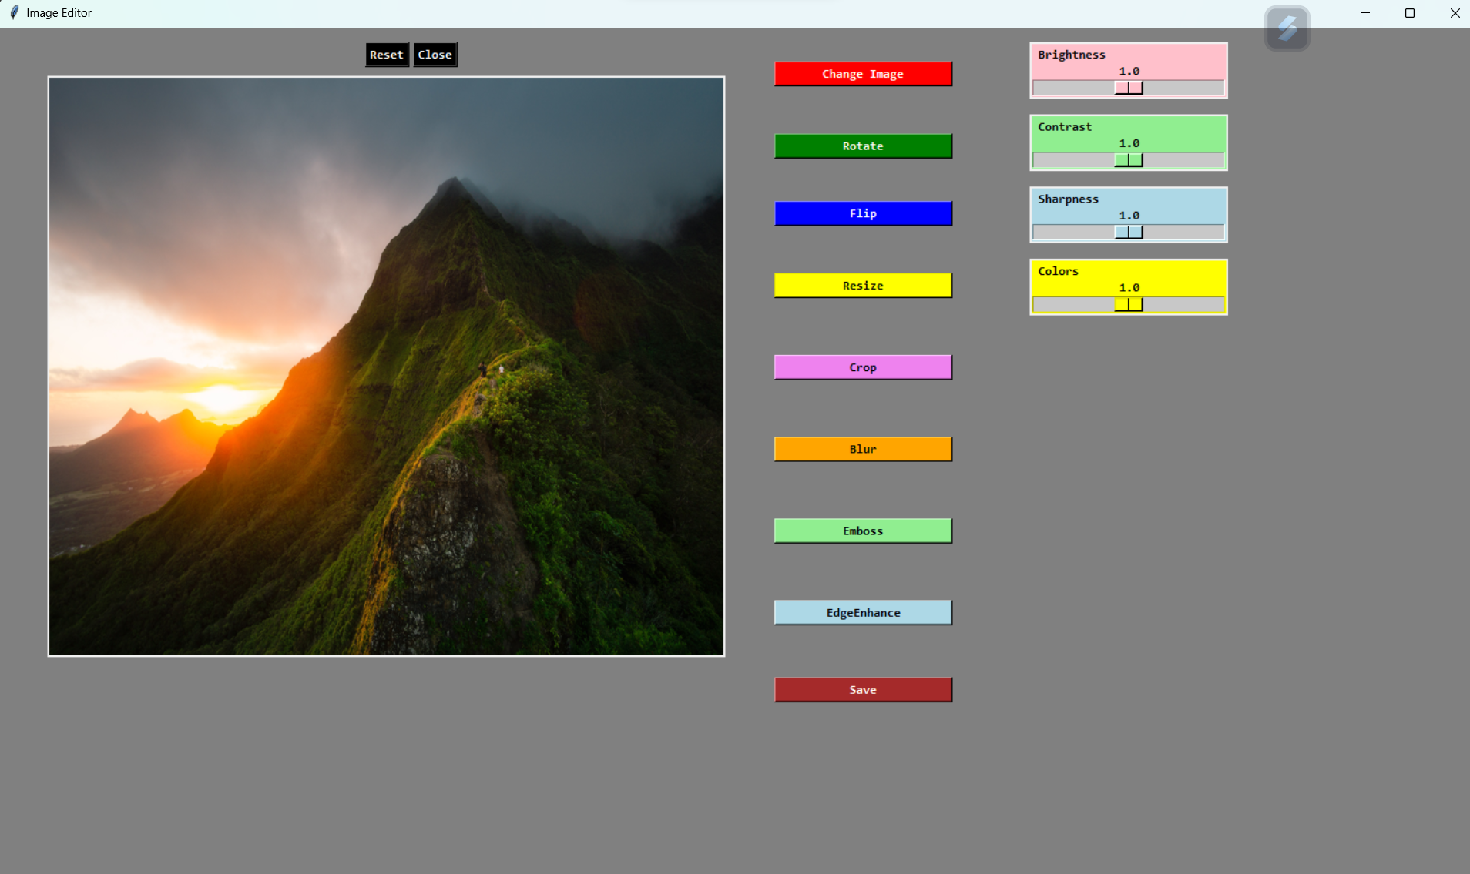
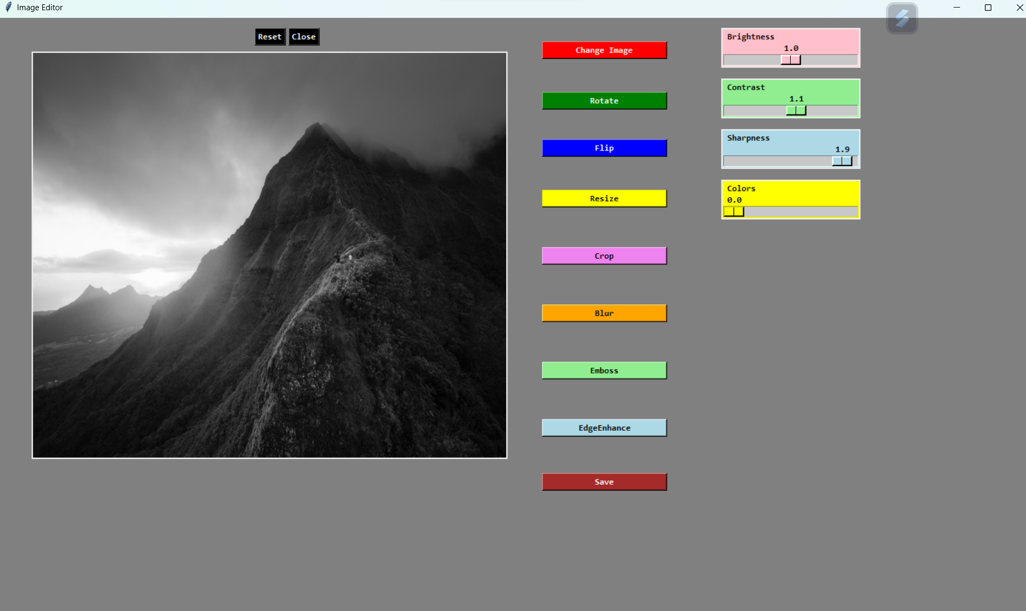
Final Output

Slide 13
Conclusion
Python is a versatile language that can be used to build GUI applications with image manipulation features. Pillow and ttk bootstrap are useful libraries for image editing and GUI design. Pillow provides various image operations and filters, while ttk bootstrap offers bootstrap-themed widgets for Tkinter. An image editor in Python can have many functionalities, such as opening, saving, flipping, rotating, filtering, drawing, and erasing images. These can be implemented using the methods and classes from the Pillow library and the widgets from the ttk bootstrap library. An image editor in Python can be a fun and educational project that demonstrates the power and creativity of Python programming. It can also be extended and customized to suit different needs and preferences.

Slide 14
Future Scope
With the advent of Artificial Intelligence (AI), photo editing software is becoming more advanced and capable of performing complex tasks with ease.
This evolution may lead to seamless, accessible editing experiences that go beyond traditional tools, incorporating features like automated restoration, style transfer, and ethical considerations.
In the future, image editors are expected to become more expensive in their individual editing and design capabilities, and more cross-compatible via easy export integrated options that are already becoming more prevalent

Slide 15
References
Gonzalez, Rafael C., and Woods, Richard E. "Digital image processing. 3E" (2008).
https://elementztechblog.wordpress.com/2015/04/14/getting-started-with-pycharm-and-qt-4-designer/
http://machinelearninguru.com/computer_vision/basics/convolution/image_convolution_1.html
https://docs.scipy.org/doc/numpy/reference/
"Python Imaging Library". Secret Labs AB. Archived from the original on 21 November 2020. Retrieved December 8, 2013.

Slide 16
END

